Slide 1
Food Ordering System
Presented By: Deepika.R Guided By: Mrs. Pavithra
Batch No: 7586
Course: Java Full Stack

Slide 2
Introduction
Online FOOD ORDERING SYSTEM will allow restaurant to quickly and easily manage an online menu which customers can browse and use to place order within just few clicks. The system then relays these orders to restaurant employees through an easy to navigate graphical interface for efficient processing.
Customers can choose one or more items to place an order which will land in cart. Customers can view all the order details in cart before the payment of his/her order.

Slide 3
Procedure..
Provides a home page to select weather or not to login as user or an admin.
After successfully login, it provides a display which will allow the user to choose the category of food which he/she wants.
After selecting the food category it will redirect to the list of foods present in the category.
Select desired food => add quantity => add to cart => order list => click payment => fill Payment Details => PAY

Slide 4
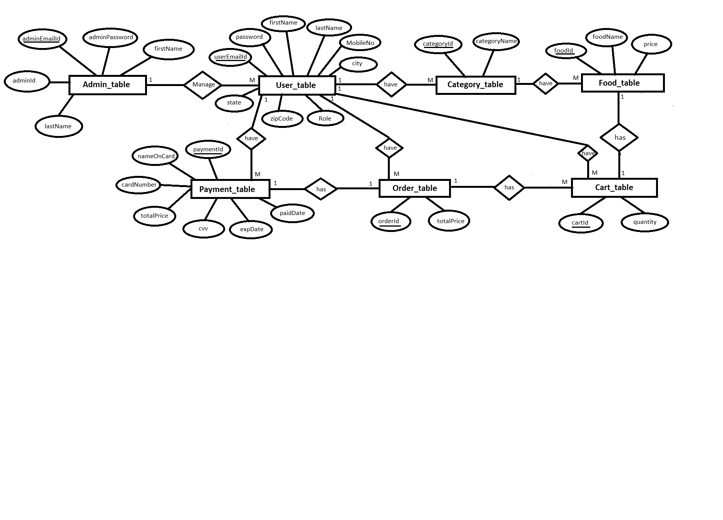

Slide 5
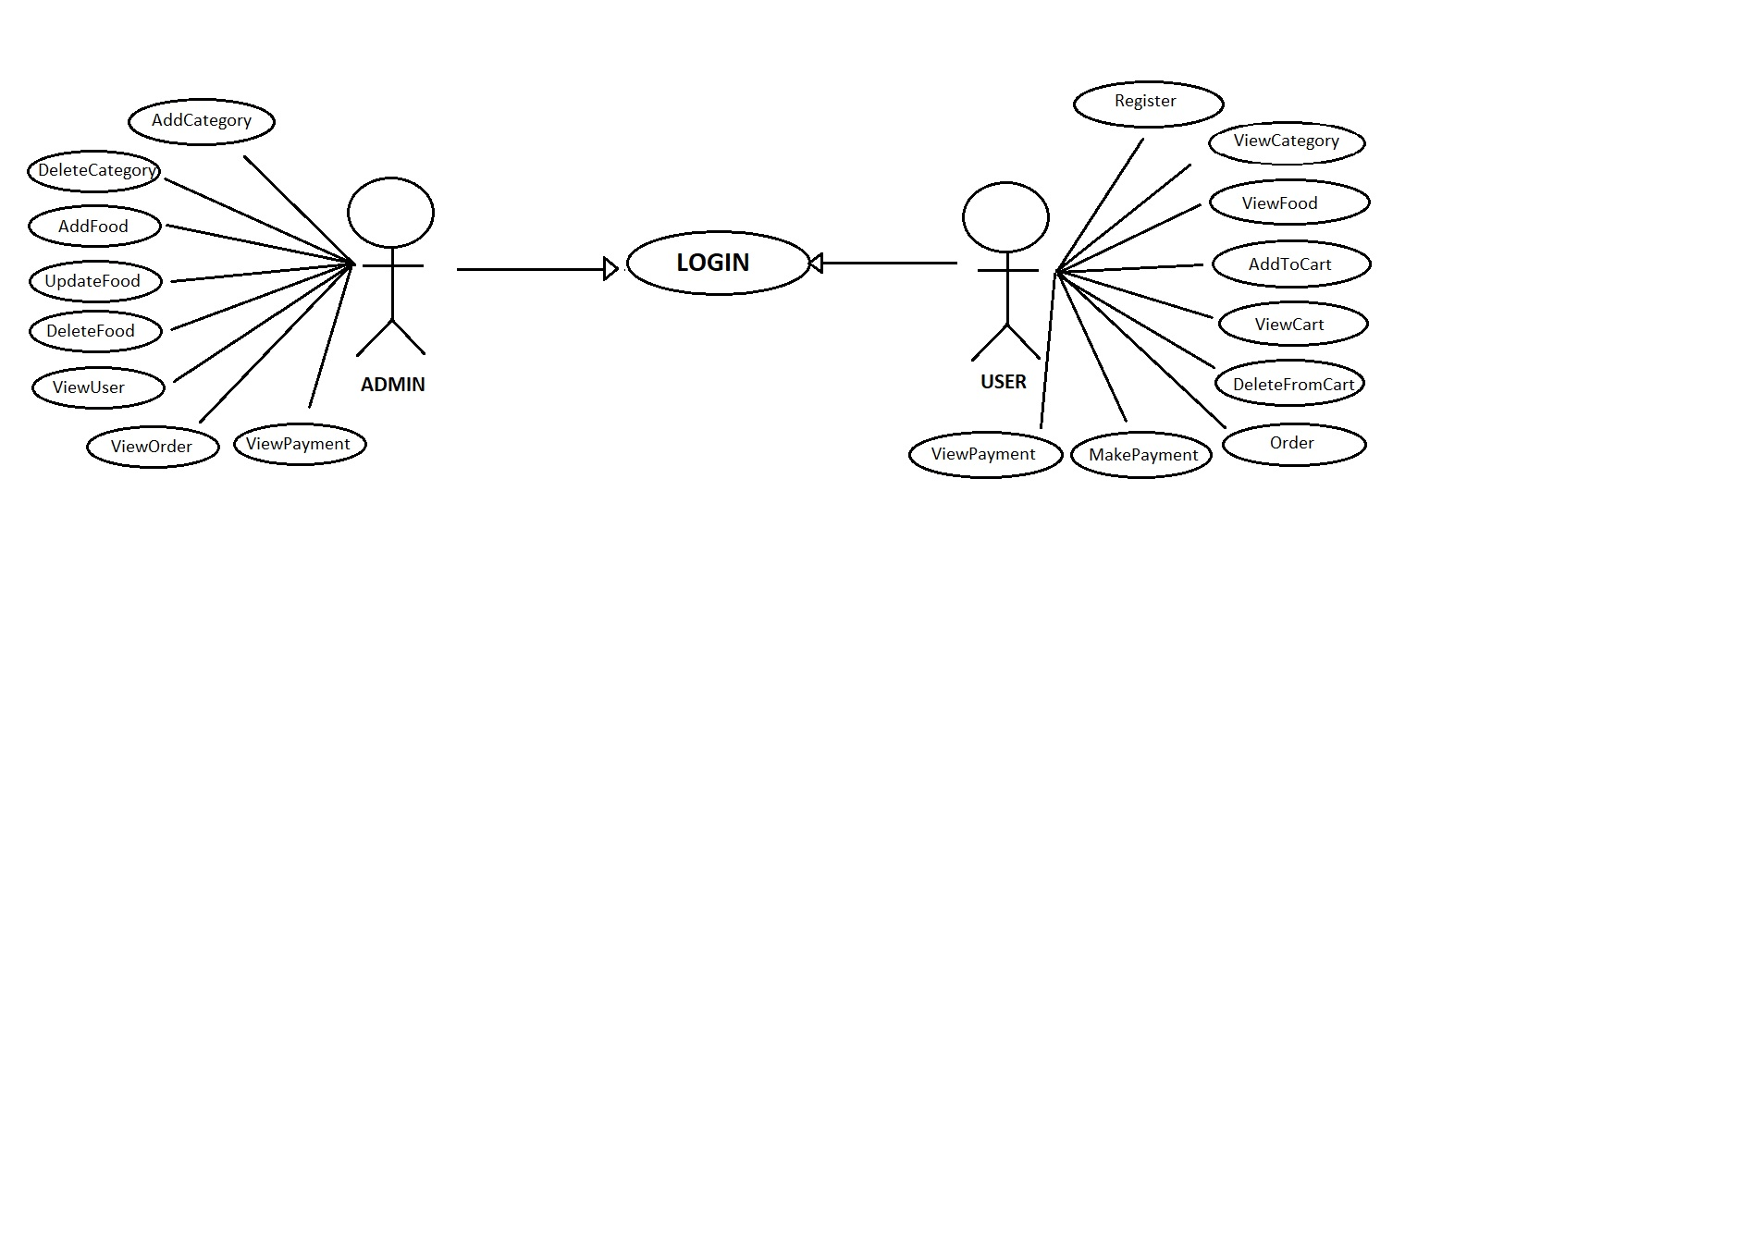

Slide 6
SOFRWARE
FRONT - END DATABASE BACK - END
Angular My-SQL Spring-Boot
Node JS Hardware Spring Core
Visual studio code Windows 10 & above JPA
TypeScript Ram: 4GB and abo Rest API
HTML 5
CSS 3
JavaScript
Postman

Slide 7
MODULE
Admin
User
Category
Food
Cart
Order
Payment

Slide 8
Spring Boot
Spring Boot is a project that is built on the top of the Spring Framework. It provides an easier and faster way to set up, configure, and run both simple and web-based applications.
Easy to understand and develop spring applications
Increases productivity
Reduces the development time

Slide 9
MySQL
MySQL is a relational database management system based on the Structured Query Language, which is the popular language for accessing and managing the records in the database.
A database is an application that stores the organized collection of records. It can be accessed and manage by the user very easily. It allows us to organize data into tables, rows, columns, and indexes to find the relevant information very quickly.

Slide 10
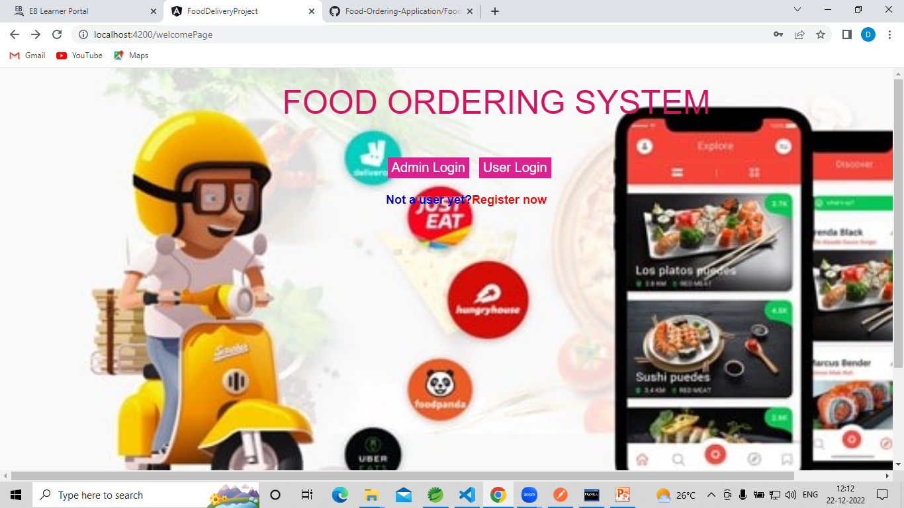
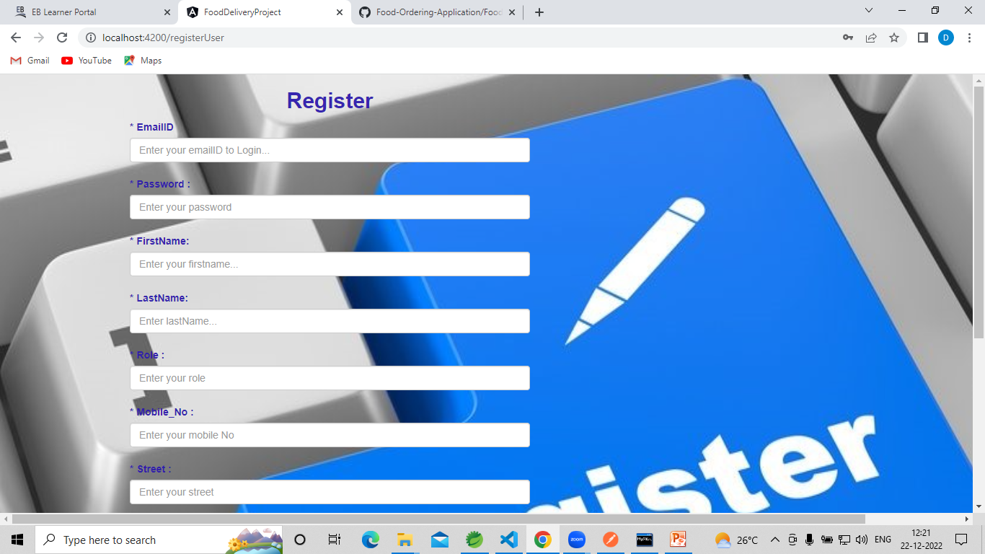
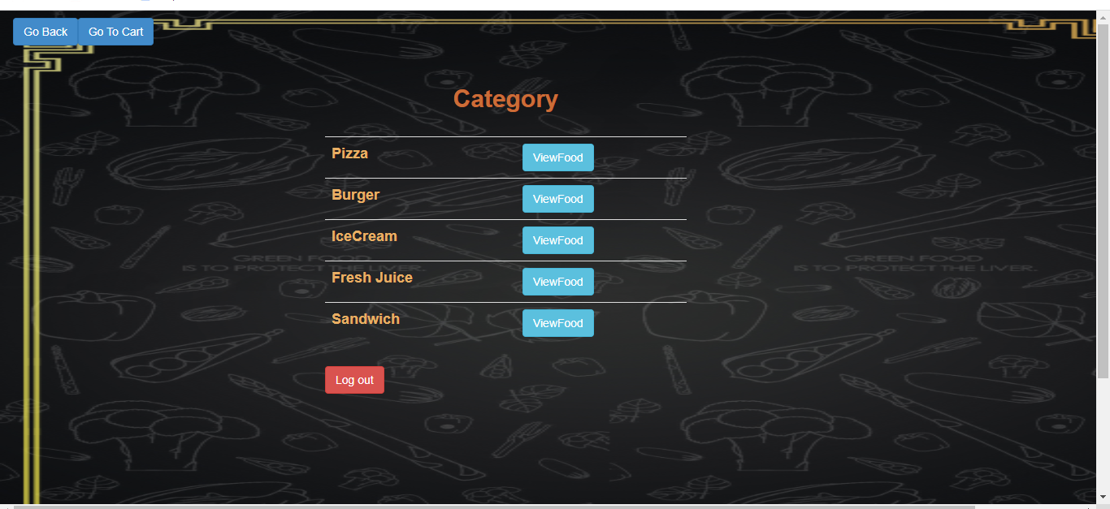
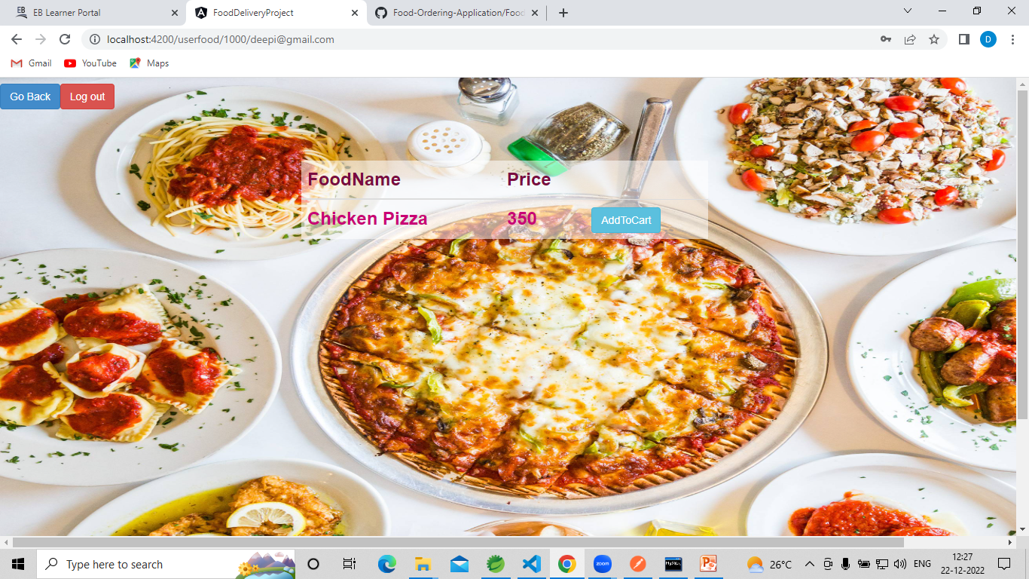

Slide 11
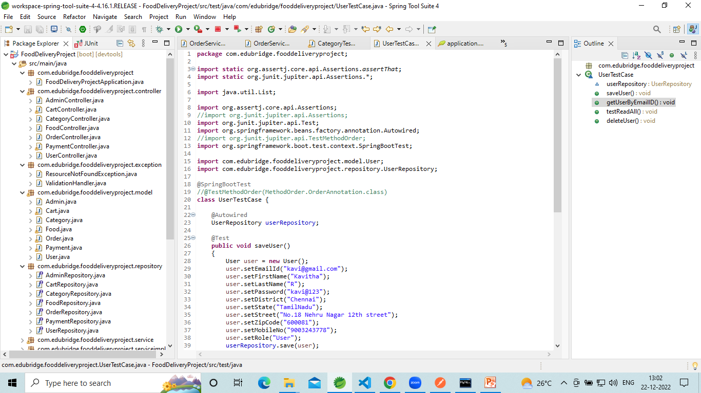
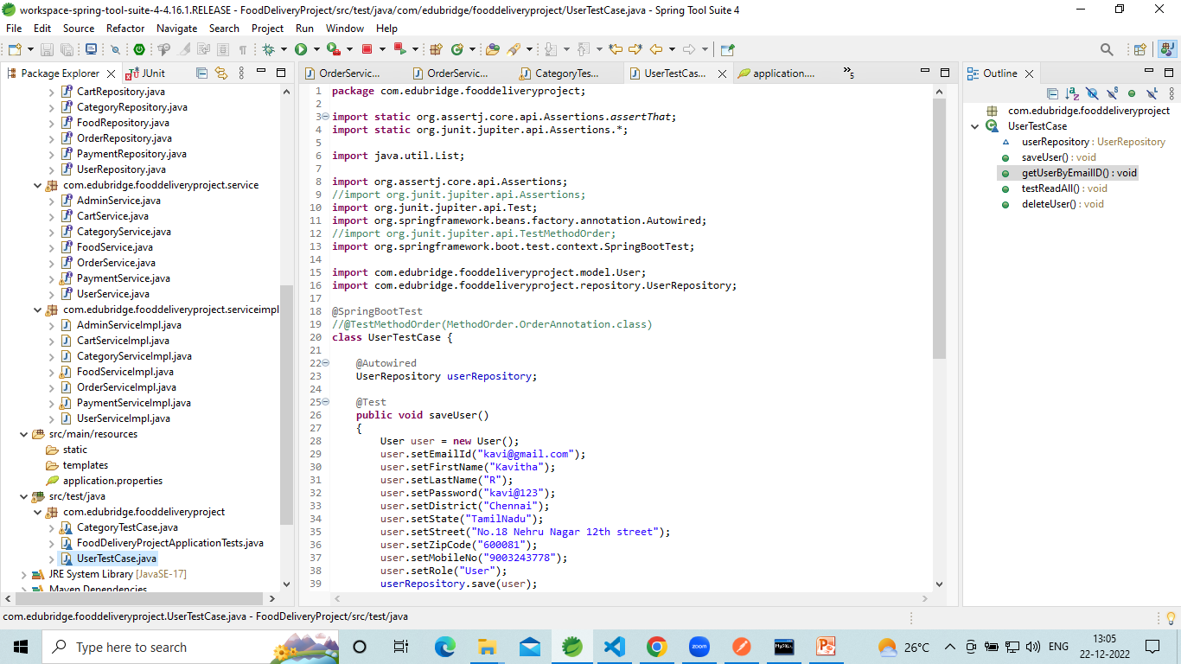
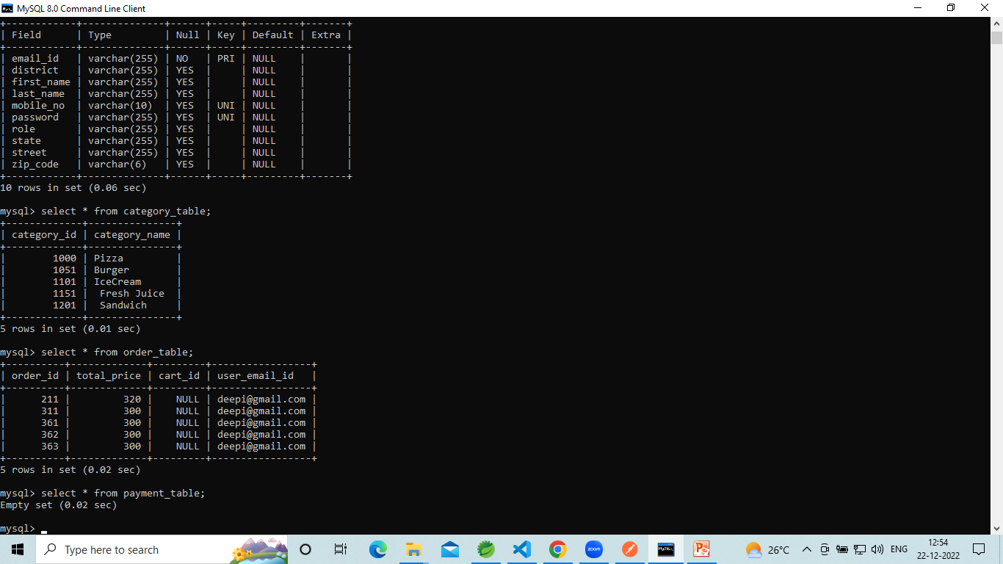

Slide 12
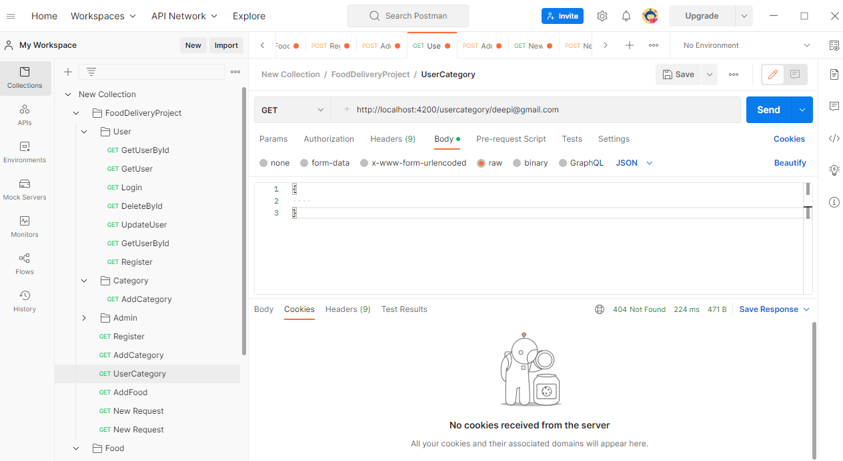

Slide 13
Testing…
Once source code has been generated, software must be tested to uncover as many errors as possible before delivery to the client. Which is very important to work the system successfully and achieve high quality of software. Testing includes designing a series of test cases that have a high likelihood of finding errors by applying software-testing techniques.
Software testing is a critical component of the software engineering process. It is an element of software quality assurance(SAQ).
System testing makes logical assumptions that if all the parts of the system are correct, the goal will be successfully achieved. The system should be checked logically. Validations and cross checks should be there. Avoid duplication of records that cause redundancy of data.

Slide 14
Future Work
Enhance User Interface by adding more user interactive features. Provide deals and promotional offer details to home page. Provide Recipes of the Week/Day to Home Page.
Payment Options: Add different payment options such as PayPal, Cash, Gift, Cards etc. Allow to save payment details for future use.
Delivery Options: add delivery options.
Order Ready notification: Send an Order Ready notification to the customer.
Customise order: Allow users to customise food order.

Slide 15
REFERENCE
https://www.w3schools.com/java/
https://www.javatpoint.com/spring-boot-tutorial
YouTube
Google searches

Slide 16


